Slide 1
The Joys of JavaScript
Lesson 3.1
Notes:
6:30

Slide 2
Admin Items
Notes:
630

Slide 3
Homework #2: Questions?
Media Queries and Viewport
Bootstrap CSS
Take existing portfolio and apply media queries and viewport to make it mobile-responsive.
Use Bootstrap CSS to re-create the portfolio you built in HW1. Your solution should minimize the use of media queries.
It also needs to be deployed on GitHub Pages and have a nice README.md
Notes:
630-32
Let bootstrap do as much work for you as you can
Open it

Slide 4

Algorithms
We now have an “algorithms” directory
These are interview-styled questions
Try these outside of class or if you have time after a pre-class drill
Notes:
632-33
We will push the answers at the end of the unit
If you want to check your answers before-hand let us know and we’ll send them to you

Slide 5
Today’s Class
Notes:
633-

Slide 6

Class Objectives
In today’s class, we will introduce:
JavaScript Definitions
JavaScript Basics
Variables
Logging, alerting, prompting
Arrays
If/else statements
Notes:
633-35

Slide 7
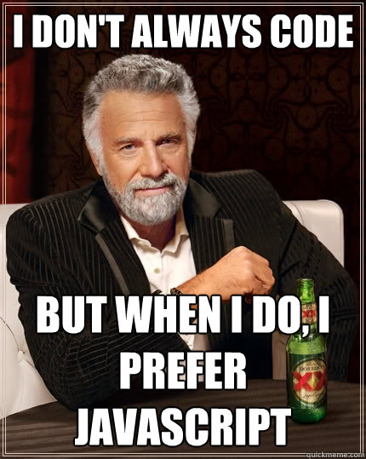
Time for JavaScript!
Notes:
635-36
shutterstock_795217711

Slide 8
JavaScript is popular!
Notes:
635-36
Image is StackOverflow survey from 2018
TAs: slack out the StackOverflow survey results in #resources (https://insights.stackoverflow.com/survey/2018)
Direct link to technologies: https://insights.stackoverflow.com/survey/2018#technology-_-programming-scripting-and-markup-languages
shutterstock_795217711

Slide 9
JavaScript is popular!
Notes:
635-36
Image is StackOverflow survey from 2018
TAs: slack out the StackOverflow survey results in #resources (https://insights.stackoverflow.com/survey/2018)
Direct link to technologies: https://insights.stackoverflow.com/survey/2018#technology-_-programming-scripting-and-markup-languages
shutterstock_795217711

Slide 10
Notes:
https://medium.com/javascript-scene/how-popular-is-javascript-in-2019-823712f7c4b1
800,000 windows apps directly on Windows Store
35 million via downloading directly
2.1 million Android apps
1.8 million iOS apps

Slide 11
JavaScript is popular!
It enabled static websites to become full-fledged applications
JavaScript is not platform specific. It can be used to build website frontends, backends, IoT, machine learning, native desktop applications and even mobile apps
Notes:
635-36
Image is StackOverflow survey from 2018
TAs: slack out the StackOverflow survey results in #resources (https://insights.stackoverflow.com/survey/2018)
Direct link to technologies: https://insights.stackoverflow.com/survey/2018#technology-_-programming-scripting-and-markup-languages
shutterstock_795217711

Slide 12
How to Learn JavaScript
Notes:
636-36

Slide 13


Your Brain on JavaScript
Notes:
636-38
Learning JavaScript will require having a lot of "little pieces" of code in your mind floating around. The key is in knowing how these pieces fit together to build useful things.
shutterstock_184763024

Slide 14
Time to Take Notes!
Notes:
638-39
This is a section where you will probably need notes to refer back to

Slide 15
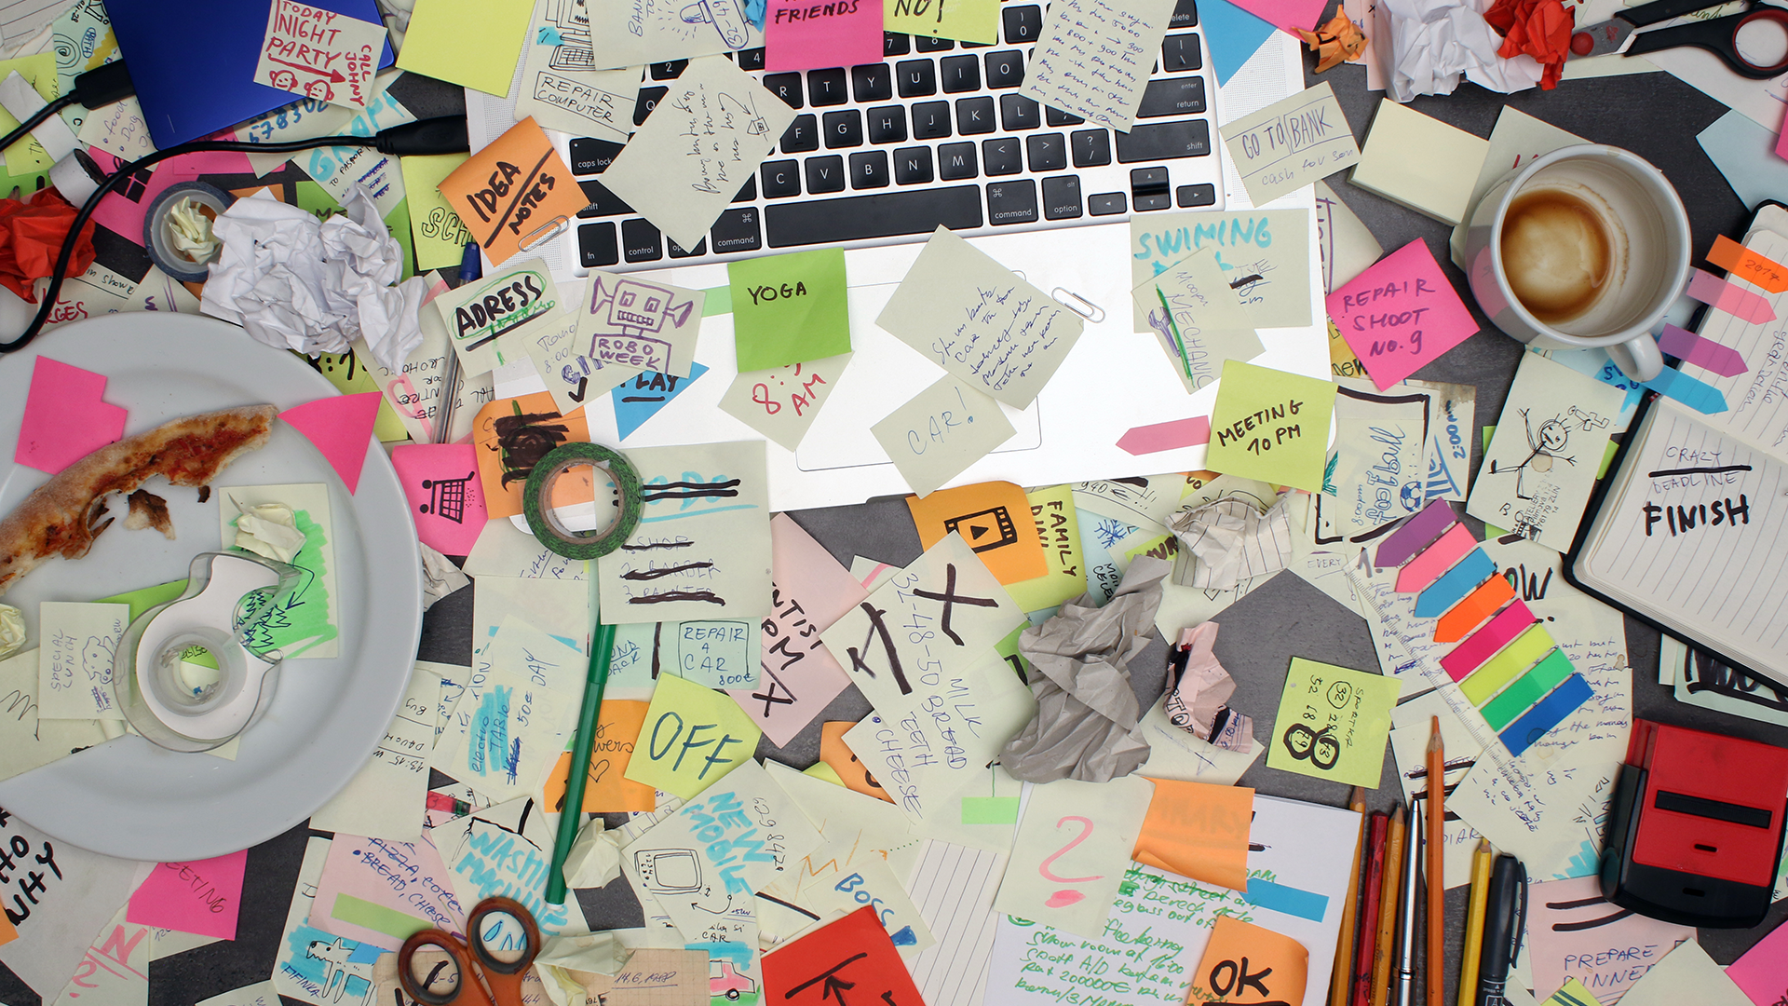
And Stay Organized!
Notes:
639-40
I’ve noticed that many people don’t have clearly organized directory structures.
As things get more complex it’s important to make sure things are organized
It’s easy to get lost otherwise – as you may have noticed
Don’t create things in the GitLab repo
shutterstock_575384821

Slide 16
Learning JavaScript
Follow these general tips:
Review classwork immediately.
Redo class activities at home.
Come to office hours and keep asking questions.
Do not fear—you will get this!
Notes:
640-42
You need to understand every activity we do
If you are stuck – ask questions
I will just redo the activity if that’s what it takes
Stay after if you want more help on an activity
The HW is a superset of all the things from the activities. You cannot do it without understanding the activities.
Hands-on experience is better than just reading

Slide 17
Partner Activity: 01-CodeDissection
A big part of being a developer is learning on the fly!
Notes:
642-49 (7 minutes)

Slide 18
Partner Activity: 01-CodeDissection
01
Open 01-CodeDissection/js-dissect.html
Open it in Chrome and observe what happens.
02
With a partner, try to explain how the code connects to the events that happen on the page.
03
Notes:
642-49 (7 minutes)
We haven’t learned JavaScript but a big part of the job is learning on the fly.
How much of this can you understand on your own?

Slide 19
What Is JavaScript?
Notes:
649-50

Slide 20


JavaScript Definition
JavaScript is one of the three fundamental programming languages of the modern web (the others are HTML and CSS).
HTML | CSS | JavaScript
Used to write content. | Used to format content. | Used to create dynamic web applications that take in user inputs, change what’s displayed to users, animate elements, and much more.
Notes:
649-51
HTML – 3%
CSS – 4%
JavaScript – 10%
Compiled to JavaScript – 83%
Most HTML/CSS is abstracted and basically included as part of our JavaScript

Slide 21
Variables
Notes:
651-51

Slide 22
Variables
The nouns of programming
Numbers, strings, Booleans, etc.
Made up of a name and a value
var name = ‘Fluffy’; var napCount = 7; var isSleeping = true;
Notes:
651-53

Slide 23
Variable Basics: Syntax
Var keyword | Variable name | Assignment | Value | Termination
var | name | = | ‘Fluffy’ | ;
Notes:
653-55

Slide 24
Variable Basics: Syntax
Var Keyword | Variable name | Assignment | Value | Termination
var | name | = | ‘Fluffy’ | ;
 |  |  | Be sure to notice the quotes (‘), which convey that Fluffy is a string.
Notes:
655-56

Slide 25
Variables
Notes:
656-706
Create new file
<body>
<script type="text/javascript">
// Variables can be strings, numbers, or booleans (true / false)
var name = 'Fluffy';
var napCount = 7;
var isSleeping = true;
</script>
</body>

Slide 26
Activity: 03-PizzaVariables
In this activity, you will fill in the missing JavaScript code to create variables.
Notes:
656-706
10 minutes
706-711 review

Slide 27
Activity: Variables
01
Using the instructions in the file sent to you, fill in the missing JavaScript code to create variables.
02
When you are done, open the file in Chrome and check the output.
03
If you successfully complete the activity, you will see a series of pop-up windows with text inside.
Finally, look at the rest of the code and try to figure out why the text displayed the way it did.
04
Notes:
656-706
10 minutes
706-711 review

Slide 28
Notes:
656-706
10 minutes
706-711 review

Slide 29
Console Log

Slide 30
Console Log
Notes:
711-16
console.log is an example of a function
This code lives in the JavaScript engine
Kind of like bootstrap gives us pre-built stuff, functions do that in languages
Make certain to show students how the console.log statement can be used to display text, variables, or a combination of the two.

Slide 31
Console.log
console.log is a quick expression that prints content to the debugger—very useful during development and debugging!
var quick = ‘Fox’; var slow = ‘Turtle’; var numbers = 121; // The console.log() method is used to display data in the the browser’s console. // We can log strings, variables, and even equations. console.log(‘Teacher’); console.log(quick); console.log(slow); console.log(numbers + 15);
Notes:
716-18

Slide 32
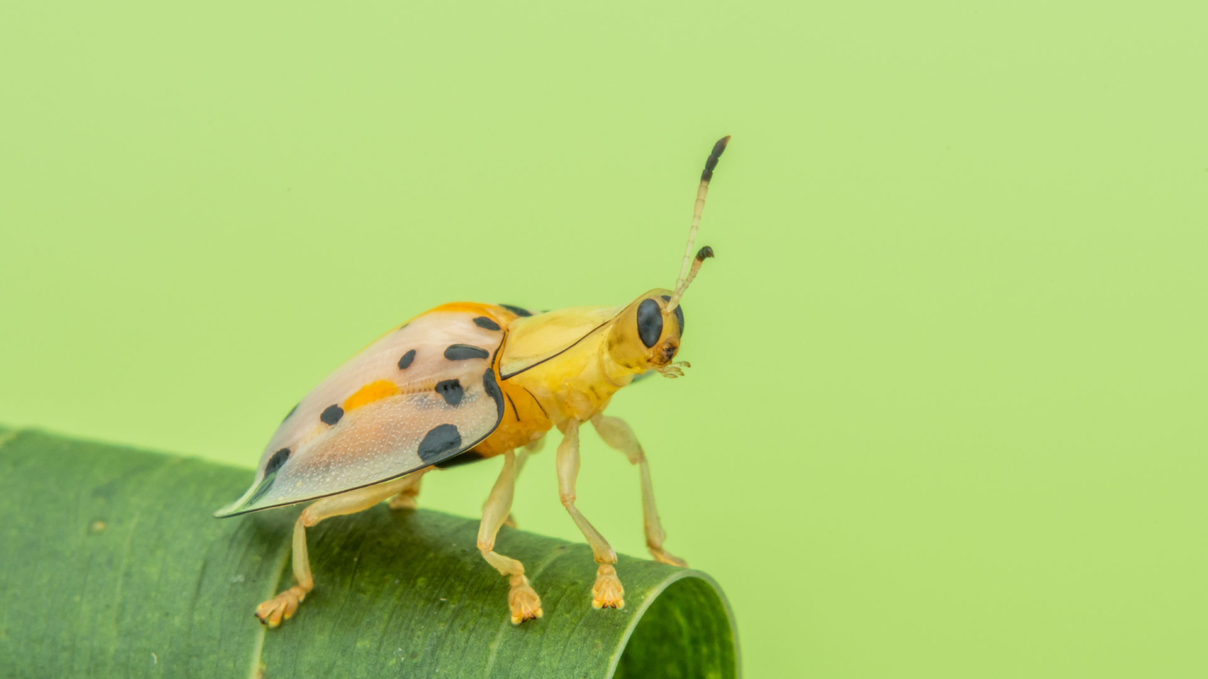
How do you comfort a JavaScript bug?
Notes:
shutterstock_1242632743

Slide 33
How do you comfort a JavaScript bug?
You "console" it!
Notes:
shutterstock_1242632743

Slide 34
Activity: Console Log
05-PizzaConsole
Notes:
718-25 7 minutes

Slide 35
Activity: Console Log (05-PizzaConsole)
01
Using the file sent to you as a guide, modify the code so that is uses console.log instead of alerts to display messages.
Then open the file in the browser and open up Chrome Developer Tools -> Console to confirm that the changes worked.
02
With a partner, discuss the difference between console.log and alert.
03
alert(’Welcome: ‘ + name); alert(‘Pizzas cost $5 each’); alert(‘Your total is: $’ + totalCost); alert(‘Still Hungry: ‘ + isHungry);
Notes:
718-25 7 minutes
Suggested Time: 7 minutes
725-30 5 minutes
review
Why would you use one over the other?

Slide 36
Notes:
15 minutes

Slide 37
Alerts, Prompts, Confirms
Notes:
BREAK
15 minutes
730-45

Slide 38
Alerts, Prompts, Confirms
Notes:
745-50 (5 min)
Demo alerts, prompts and confirms
Explain that functions that "give you something back" are said to return something.
Explain that prompt and confirm return whatever the user enters in the text prompt.

Slide 39
Alerts, Prompts, Confirms
Alerts, prompts, and confirms create a popup in the browser when run.
These are also useful for development and debugging.
// Alert alert(‘We definitely rock!’); // Confirm var doYouRock = confirm(‘The question is, do “you” rock?’); // Prompt var howMuchRock = prompt(‘How much do you rock?’);
This page says:
We definitely rock!
OK
This page says:
The question is, do “you” rock?
Prevent this page from creating additional dialogs.
OK
Cancel
This page says:
How much do you rock?
Prevent this page from creating additional dialogs.
OK
Cancel
Notes:
750-53

Slide 40
Activity: Alerts
07-PromptSushi
Notes:
753-808 (15 min)

Slide 41
Activity: Alerts (07-PromptSushi)
Write JavaScript code that does the following:
01
Using a confirm, ask the user “Do you like _____?” and store their response in a variable.
Using a prompt, ask the user: “What kind of _____ do you like?” and store their response in a variable.
02
alert both variables to the screen.
03
Notes:
753-808 (15 min)
* Using a confirm, ask the user, "Do you like \_?" Store their response in a variable.
* Using a prompt, ask the user, "What kind of \_ do you like?" Store their response in a variable.
* Alert both variables to the screen.
<body>
<script type="text/javascript">
// Creates a confirm box which takes in true or false.
var doesLikeAnime = confirm('Do you like anime?');
// Creates a prompt box which takes in text input.
var favoriteAnime = prompt('What anime is your favorite?');
// Alerts the output from our confirm box.
alert('Your anime preference is: ' + doesLikeAnime);
// Alerts the output from our prompt box.
alert('Your favorite anime is ' + favoriteAnime + ' ');
</script>
</body>

Slide 42
Notes:
808-813
review

Slide 43
If/Else Statements
Notes:
813-23
Talk about what this control flow means

Slide 44
Conditionals
Notes:
813-23
Talk about what this control flow means
08-ConditionalDemo
Code the below – just update the previous activity
// Here we create our prompt and confirm variables which will store user input.
var confirmSushi = confirm("Do you like sushi?");
var confirmGingerTea = confirm("Do you like Ginger Tea?");
var sushiType = prompt("What kind of sushi do you like?");
// If the user likes sushi (confirmSushi === true), we run the following block of code.
if (confirmSushi) {
alert("You like " + sushiType + "!");
}
// If the user likes ginger tea (confirmGingerTea === true), we run the following block of code.
else if (confirmGingerTea) {
alert("You like ginger tea!!");
}
// If neither of the previous condition were true, we run the following block of code.
else {
alert("You don't like sushi or ginger tea.");
}

Slide 45
If/Else Statements Are Critical
Each statement is composed of an if, else-if, or else (keyword), a condition, and the resulting code in curly brackets { }.
// If the user likes sushi (confirmSushi === true), we run the following block of code. if (confirmSushi) { alert(‘You like ‘ + sushiType + ‘!’); } // If the user likes ginger tea (confirmGingerTea === true), we run the following block of code. else if (confirmGingerTea) { alert(‘You like ginger tea!!’); } // If neither of the previous condition were true, we run the following block of code. else { alert("You don’t like sushi or ginger tea."); }
Notes:
823-25

Slide 46
Partner Activity: If/Else Part 1
With a partner you will create a website (from scratch) that asks users if they eat steak. (09-ConditionalActivity)
Notes:
825-40
15 minutes

Slide 47

Partner Activity: If/Else Part 1 (09-ConditionalActivity)
01
With a partner, create a website (from scratch) that asks users if they eat steak.
If they respond with yes, alert the following to the page: “Here’s a Steak Sandwich!”.
02
If they respond with no alert the following to the page: “Here’s a Tofu Stir-Fry!”.
03
Bonus: Ask what the user’s birth year is. If they are under 21, alert the following: “No sake for you!”
Notes:
825-40 (15 min)
Add more to birth year
If > 1998
// Here we ask the user if they eat steak, and store the result (true/false) in a variable.
var eatSteak = confirm("Do you eat steak?");
// If the user eats steak (eatSteak === true) we run the following code block.
if (eatSteak) {
alert("Here's a steak");
}
// If the above condition isn't met (eatSteak !== true), run the following block of code instead.
else {
alert("Here's a tofu stir fry!");
}
// Bonus
// Here we ask the user what year they were born, and store their response to a variable.
var birthYear = prompt("What year were you born?");
// If the user was born before 1997, alert "SAKE SAKE SAKE!"
if (birthYear < 1997) {
alert("SAKE SAKE SAKE!");
}
// Else if the user was born after 1997, alert "No Sake for you!"
else if (birthYear > 1997) {
alert("No Sake for you!");
}
// If neither of the previous conditions was true (birthYear === 1995) we alert "You inched by!"
else {
alert("You inched by! Sake Sake Sake!");
}

Slide 48
Notes:
840-50 (10 min)
TAs: Slack out the video review for this activity which can be found here.
https://www.youtube.com/watch?v=rlhhRVO5EOg
If > 1998
// Here we ask the user if they eat steak, and store the result (true/false) in a variable.
var eatSteak = confirm("Do you eat steak?");
// If the user eats steak (eatSteak === true) we run the following code block.
if (eatSteak) {
alert("Here's a steak");
}
// If the above condition isn't met (eatSteak !== true), run the following block of code instead.
else {
alert("Here's a tofu stir fry!");
}
// Bonus
// Here we ask the user what year they were born, and store their response to a variable.
var birthYear = prompt("What year were you born?");
// If the user was born before 1997, alert "SAKE SAKE SAKE!"
if (birthYear < 1997) {
alert("SAKE SAKE SAKE!");
}
// Else if the user was born after 1997, alert "No Sake for you!"
else if (birthYear > 1997) {
alert("No Sake for you!");
}
// If neither of the previous conditions was true (birthYear === 1995) we alert "You inched by!"
else {
alert("You inched by! Sake Sake Sake!");
}

Slide 49
Activity: If/Else Part 2 (10-ConditionalActivity2)
As a class, we will go through and predict what the result of a conditional statement will be.
Notes:
850-9
10 minutes

Slide 50
Activity: If/Else Part 2
Class activity (everyone together)
Open 10-ConditionalActivity2/conditional-demo-2.html
As a class, go through and predict what the result of each conditional statement will be (i.e., will the “if” or the “else” be triggered).
We’ll check answers as we go
Notes:
850-9
Suggested Time: 10 minutes
Just go through the file

Slide 51
Arrays
Notes:
9

Slide 52
The Zoo Pen
Array Name: zooAnimals
Zebra | Rhino | Giraffe | Owl
Index 0 | Index 1 | Index 2 | Index 3
Notes:
9-03
I have a collection of markers

Slide 53
The Zoo Pen: Coded
Array Name: zooAnimals
Coded in JavaScript using an Array
Coded in JavaScript using an array:
Zebra | Rhino | Giraffe | Owl
Index 0 | Index 1 | Index 2 | Index 3
// Our array of zoo animals. var zooAnimals = [‘Zebra’, ‘Rhino’, ‘Giraffe’, ‘Owl’];
Notes:
9-903

Slide 54
Arrays
Arrays are a type of variable that are collections.
These collections can be made up of strings, numbers, Booleans, other arrays, objects … anything.
Each element of the array is marked by an index. Indexes always start with 0.
var nickCharacters = [‘Tommy’, ‘Doug’, ‘Oblina’]; var diceNumbers = [1, 2, 3, 4, 5, 6,]; var mixedArray = [‘Zoo’, 12, ‘Carrot’, 3];
Notes:
903-05

Slide 55
Arrays: Indices
To recover the value at any specific index, include the name of the array with a square bracket [ ] and inside the bracket is the element’s index.
You can easily grab the number of elements in the array using the method array.length.
// Our array of zoo animals. var zooAnimals = [‘Zebra’, ‘Rhino’, ‘Giraffe’, ‘Owl’]; // Prints 4 to the console because there are 4 items in our zooAnimals array. console.log(zooAnimals.length); // Prints Rhino to the console. Remember, the first item in an array has an index position of 0! console.log(zooAnimals[1]); // Prints undefined...because the last index ("Owl") is 3. console.log(zooAnimals[4]);
Notes:
905-7

Slide 56
Arrays
Notes:
907-12 (5 min)
Open the file arrays-demo.html in 11-ArraysDemo. Show students how this example matches the one in the slides.
Point out how the index system works (i.e. starts at 0 and ends one before the length).
Code it myself
// Our array of zoo animals.
var zooAnimals = ['Zebra', 'Rhino', 'Giraffe', 'Owl'];
// Prints 4 to the console because there are 4 items in our zooAnimals array.
console.log(zooAnimals.length);
// Prints Rhino to the console. Remember, the first item in an array has an index position of 0!
console.log(zooAnimals[1]);
// Prints undefined... because the last index ("Owl") is 3.
console.log(zooAnimals[4]);

Slide 57
Partner Activity: Code Dissection (12-ArraysActivity)
With a partner, take a few moments to look over the code in 12-ArraysActivity
Above each console.log(), write a comment predicting what you think the output will be.
Notes:
912-19
Suggested Time: 7 minutes
919-22
review

Slide 58
Questions, Comments, Concerns?
Notes:
922-27

Slide 59
Homework #3
Notes:
927-30
Demo it

Slide 60
Challenge: Favorite Band Array
In this challenge, you will create an array of your favorite bands.
Notes:
930-45
15 minutes
13-Bands
<script>
// Created an array named myBands.
var myBands = ['lindsey stirling', 'hiroyuki sawano', '2cellos', 'akino', 'asami tachibana'];
// Created a prompt to get the user's favorite band.
var userGuess = prompt('Which band or artist do you like?');
// Converts the user's answer to lowercase.
var userGuessLower = userGuess.toLowerCase();
// Now we check the myBands array to see if it contains the user's answer.
// If the user's band is not in the array...
if (myBands.indexOf(userGuessLower) === -1) {
alert('Nah! They are pretty lame...');
}
// If it is in the array...
else {
alert('OMG! I love them too!');
}
</script>

Slide 61
Challenge: Favorite Band Array (13-Bands)
Create a website that accomplishes the following:
01
Create an array of your favorite bands.
02
With a prompt, ask the user’s favorite band.
03
If it’s one of your favorites, alert: “YEAH, I LOVE THEM!”
04
If it’s not, alert: “Nah. They’re pretty lame.”
Hint: You will need to research how to use .indexOf()
Hint: You will also need to research how to use .toLowerCase()
Notes:
930-45
Suggested Time: 15 minutes

Slide 62
Challenge: Code Dissection (Re-examined)
Re-examine the file sent to you at the start of class. See if you can better understand how it works after having completed today’s class.
Notes:
945-57
12 minutes
For the second challenge, students should go back to the first example shown in class (the js-dissect.html file in 01-CodeDissection. Have them re-examine the code to see if they understand it better.
14-JSDissect
Go through each line

